Slide 1
Can A.I. recommend your next favorite perfume? An n.L.P. approach
D. Alex Lou
d.alexlou17@gmail.com
www.linkedin.com/in/david-alexander-lou

Slide 2
How do you currently pick out a new fragrance?
Notes:
Try out a few that look appealing
Ask the perfume clerk at a store
Look up you favorite perfume description and try to find

Slide 3
How do you currently pick out a new fragrance?
Notes:
Try out a few that look appealing
Ask the perfume clerk at a store
Look up you favorite perfume description and try to find

Slide 4
How do you currently pick out a new fragrance?
Notes:
Try out a few that look appealing
Ask the perfume clerk at a store
Look up you favorite perfume description and try to find

Slide 5
How do you currently pick out a new fragrance?
Notes:
Try out a few that look appealing
Ask the perfume clerk at a store
Look up you favorite perfume description and try to find

Slide 6
How do you currently pick out a new fragrance?
Notes:
Try out a few that look appealing
Ask the perfume clerk at a store
Look up you favorite perfume description and try to find

Slide 7
How do you currently pick out a new fragrance?
Notes:
Commission
Pushing whatever manager says to sell
Upsell you

Slide 8
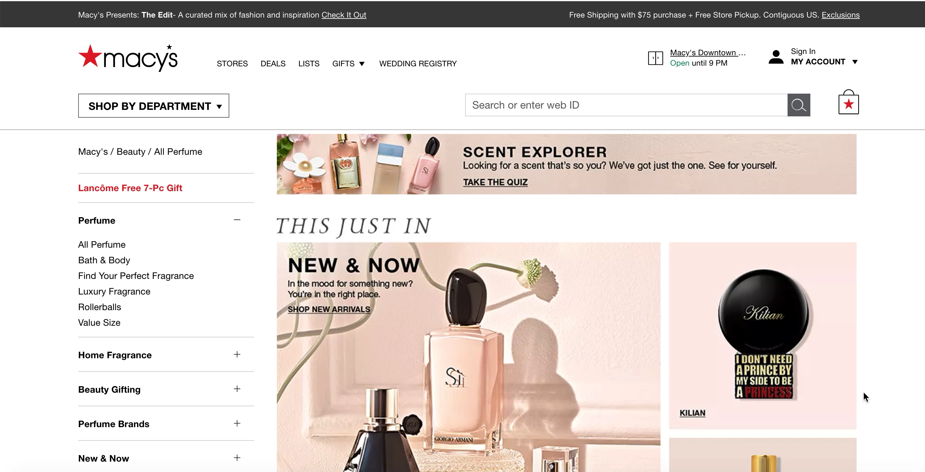
How do you currently pick out a new fragrance?

Slide 9
What would the tech look like?
Simple user interface:
Enter current/Favorite Fragrance
App would suggest 3 similar fragrances:
From 3 different designers
Include prices descriptions
Location in the department
Flag a store clerk

Slide 10

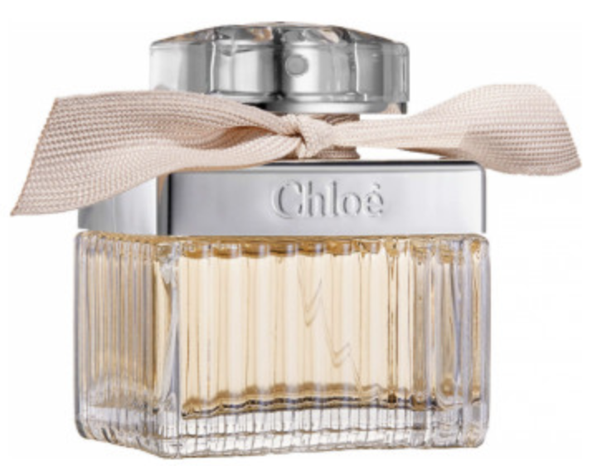
The A.i. in action
Enters into the kiosk:
Notes:
“You shall know a word by the company it keeps” – J.R. Firth

Slide 11
The A.I. in action
A fresh and feminine fragrance suited to a free spirit with an utterly innate sense of chic. The scent takes the classic rose and ingeniously translates it into a vibrant perfume, intimate and sensual.
Chloé Eau de Parfum begins with a combination of floral powdery notes, hints of peony and lychee and springtime freesia. The airy, flirtatious head notes drift away to reveal the richer and more sensual side of the rose. The distinctive character of this unique rose is accompanied by magnolia and lily of the valley, as well as subtle intimations of warm amber and elegant cedarwood.
Top Notes: Pink Peony, Freesia, Lychee
Heart Notes: Magnolia Flower, Lily of the Valley, Rose
Dry Down: Cedarwood, Amber, Honey

Slide 12
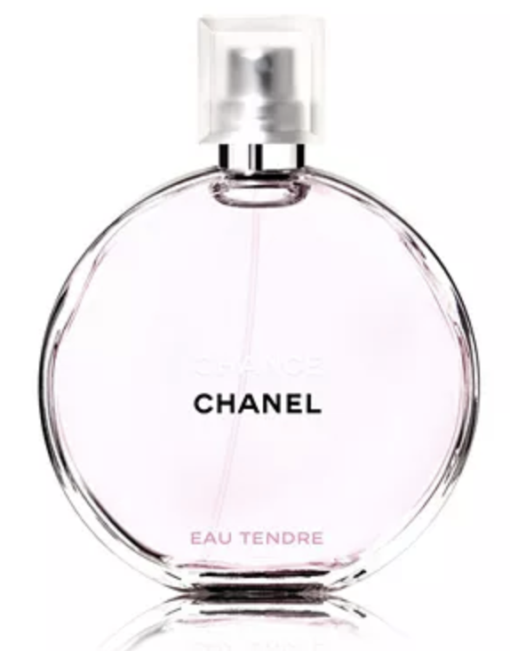
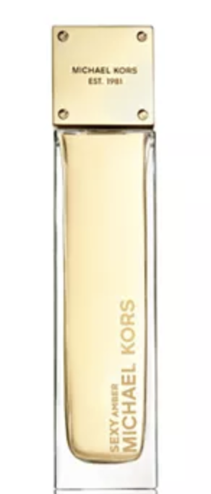
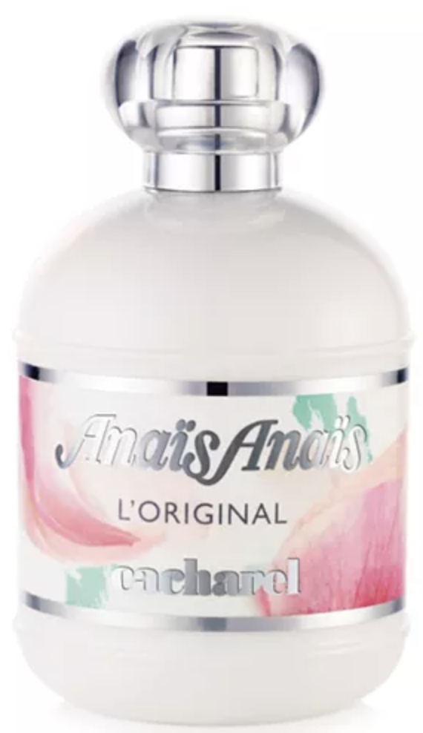
The A.I. in action
Chanel
“chance”
Michael Kors
“Sexy amber”
Cacharel
“anais anais”

Slide 13
The A.i. in action
Chloe – “Chloe”
Chanel – “Chance”
A fresh and feminine fragrance suited to a free spirit with an utterly innate sense of chic. The scent takes the classic rose and ingeniously translates it into a vibrant perfume, intimate and sensual.
Chloé Eau de Parfum begins with a combination of floral powdery notes, hints of peony and lychee and springtime freesia. The airy, flirtatious head notes drift away to reveal the richer and more sensual side of the rose. The distinctive character of this unique rose is accompanied by magnolia and lily of the valley, as well as subtle intimations of warm amber and elegant cedarwood.
Top Notes: Pink Peony, Freesia, Lychee
Heart Notes: Magnolia Flower, Lily of the Valley, Rose
Dry Down: Cedarwood, Amber, Honey
Fragrance Family: Fresh Scent Type: Fresh Fruity Florals Key Notes: Citron, Jasmine, Teakwood Fragrance Description: A fresh, sparkling floral expression of CHANCE—a surge of energy that sweeps you into a whirlwind of happiness and fantasy. A whirlwind of energy and vitality intertwines the zesty freshness of Citron with the softness of Jasmine and the vibrant presence of Teak Wood.

Slide 14
The A.i. in action
Chloe – “Chloe”
Chanel – “Chance”
A fresh and feminine fragrance suited to a free spirit with an utterly innate sense of chic. The scent takes the classic rose and ingeniously translates it into a vibrant perfume, intimate and sensual.
Chloé Eau de Parfum begins with a combination of floral powdery notes, hints of peony and lychee and springtime freesia. The airy, flirtatious head notes drift away to reveal the richer and more sensual side of the rose. The distinctive character of this unique rose is accompanied by magnolia and lily of the valley, as well as subtle intimations of warm amber and elegant cedarwood.
Top Notes: Pink Peony, Freesia, Lychee
Heart Notes: Magnolia Flower, Lily of the Valley, Rose
Dry Down: Cedarwood, Amber, Honey
Fragrance Family: Fresh Scent Type: Fresh Fruity Florals Key Notes: Citron, Jasmine, Teakwood Fragrance Description: A fresh, sparkling floral expression of CHANCE—a surge of energy that sweeps you into a whirlwind of happiness and fantasy. A whirlwind of energy and vitality intertwines the zesty freshness of Citron with the softness of Jasmine and the vibrant presence of Teak Wood.

Slide 15
The A.i. in action
Chloe – “Chloe”
Chanel – “Chance”
A fresh and feminine fragrance suited to a free spirit with an utterly innate sense of chic. The scent takes the classic rose and ingeniously translates it into a vibrant perfume, intimate and sensual.
Chloé Eau de Parfum begins with a combination of floral powdery notes, hints of peony and lychee and springtime freesia. The airy, flirtatious head notes drift away to reveal the richer and more sensual side of the rose. The distinctive character of this unique rose is accompanied by magnolia and lily of the valley, as well as subtle intimations of warm amber and elegant cedarwood.
Top Notes: Pink Peony, Freesia, Lychee
Heart Notes: Magnolia Flower, Lily of the Valley, Rose
Dry Down: Cedarwood, Amber, Honey
Fragrance Family: Fresh Scent Type: Fresh Fruity Florals Key Notes: Citron, Jasmine, Teakwood Fragrance Description: A fresh, sparkling floral expression of CHANCE—a surge of energy that sweeps you into a whirlwind of happiness and fantasy. A whirlwind of energy and vitality intertwines the zesty freshness of Citron with the softness of Jasmine and the vibrant presence of Teakwood.

Slide 16
The A.i. in action
Chloe – “Chloe”
Chanel – “Chance”
A fresh and feminine fragrance suited to a free spirit with an utterly innate sense of chic. The scent takes the classic rose and ingeniously translates it into a vibrant perfume, intimate and sensual.
Chloé Eau de Parfum begins with a combination of floral powdery notes, hints of peony and lychee and springtime freesia. The airy, flirtatious head notes drift away to reveal the richer and more sensual side of the rose. The distinctive character of this unique rose is accompanied by magnolia and lily of the valley, as well as subtle intimations of warm amber and elegant cedarwood.
Top Notes: Pink Peony, Freesia, Lychee
Heart Notes: Magnolia Flower, Lily of the Valley, Rose
Dry Down: Cedarwood, Amber, Honey
Fragrance Family: Fresh Scent Type: Fresh Fruity Florals Key Notes: Citron, Jasmine, Teakwood Fragrance Description: A fresh, sparkling floral expression of CHANCE—a surge of energy that sweeps you into a whirlwind of happiness and fantasy. A whirlwind of energy and vitality intertwines the zesty freshness of Citron with the softness of Jasmine and the vibrant presence of Teakwood.

Slide 17
The A.i. in action
Chloe – “Chloe”
Chanel – “Chance”
A fresh and feminine fragrance suited to a free spirit with an utterly innate sense of chic. The scent takes the classic rose and ingeniously translates it into a vibrant perfume, intimate and sensual.
Chloé Eau de Parfum begins with a combination of floral powdery notes, hints of peony and lychee and springtime freesia. The airy, flirtatious head notes drift away to reveal the richer and more sensual side of the rose. The distinctive character of this unique rose is accompanied by magnolia and lily of the valley, as well as subtle intimations of warm amber and elegant cedarwood.
Top Notes: Pink Peony, Freesia, Lychee
Heart Notes: Magnolia Flower, Lily of the Valley, Rose
Dry Down: Cedarwood, Amber, Honey
Fragrance Family: Fresh Scent Type: Fresh Fruity Florals Key Notes: Citron, Jasmine, Teakwood Fragrance Description: A fresh, sparkling floral expression of CHANCE—a surge of energy that sweeps you into a whirlwind of happiness and fantasy. A whirlwind of energy and vitality intertwines the zesty freshness of Citron with the softness of Jasmine and the vibrant presence of Teakwood.
Notes:
“You shall know a word by the company it keeps” – J.R. Firth

Slide 18
Conclusion – Benefits of this A.I.
Increase customer experience
Reduce f.t.e. (full-time employment)
Collect additional marketing data (what are customers searching for in the app)

Slide 19
Thank you!
Name & contact Information:
D. Alex Lou (Data Scientist)
d.alexlou17@gmail.com
linkedin.com/in/david-alexander-lou
Github.com/alou127

Slide 20
Appendix:
Data
1,150 different perfumes
descriptions, prices, designer, fragrance name
All scraped from Macy’s Website

Slide 21
Appendix:
NLP Algorithm/pipeline:
Cleans/tokenizes all the individual word in the corpus (body of descriptions)
One hot encodes each perfume (row) into 3,300 dimensional space
Non-negative matrix factorization ➤ 35 Dimensions
Cosine similarity to compare descriptions of perfumes

Slide 22
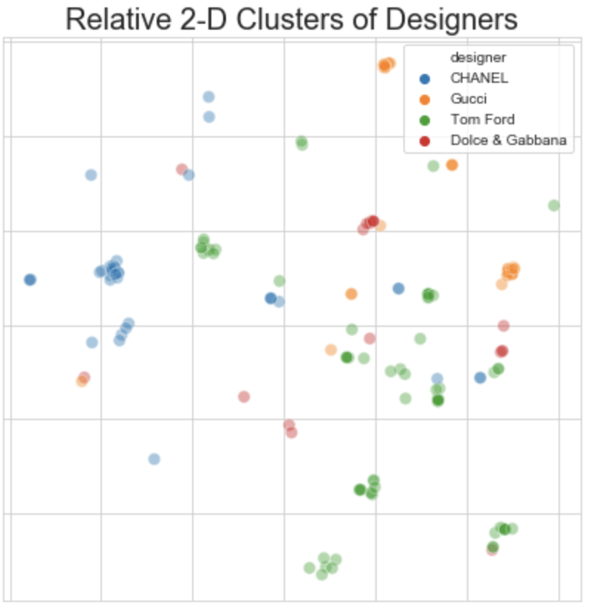
Appendix:

Slide 23
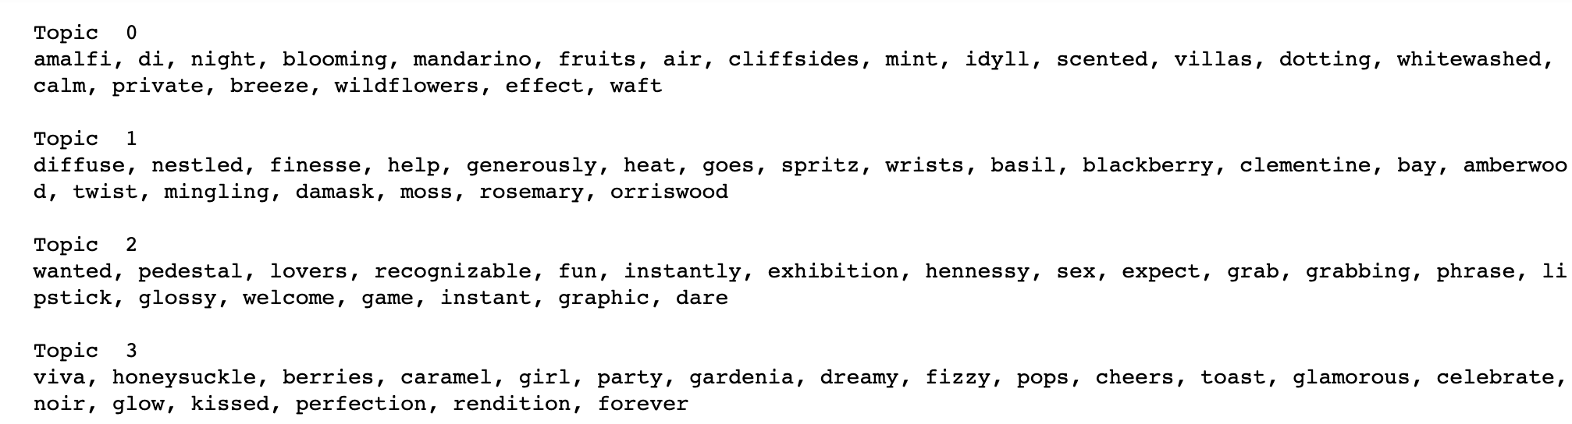
Appendix:

